Slide 1
Admission INFO
System APP
JAVA LAB PROJECT
Presented By:
Md. Mahfujur Rahman (011161156)
Syed Adib Arman (011161251)
Inspired By-
Mousumi Akter
Dept of CSE.

Slide 2
SOFTWARE USED……
Netbeans
GRAPHICAL USER INTERFACE(GUI)

Slide 3
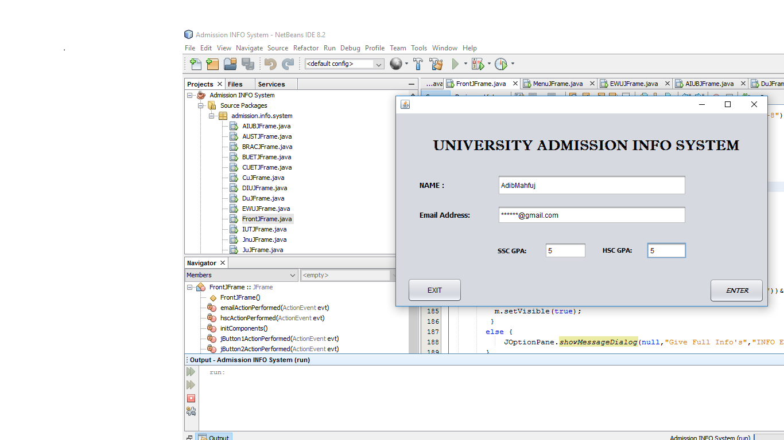
FRONT PAGE…..

Slide 4
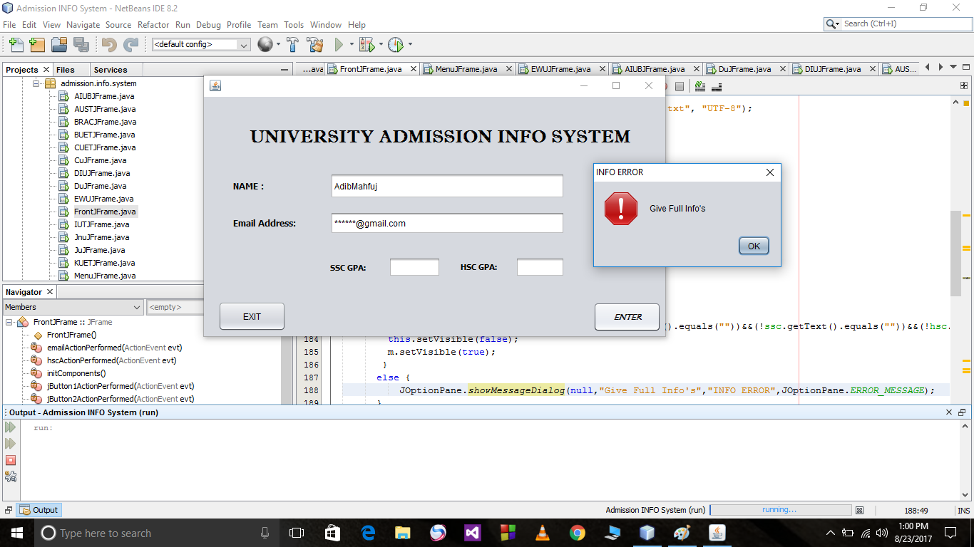
Incomplete INFO….

Slide 5
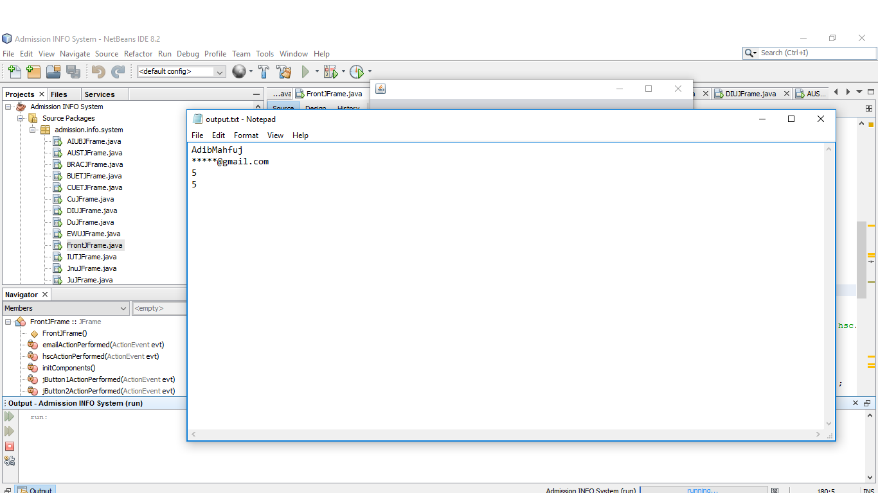
Save Info Into our Data collection..

Slide 6
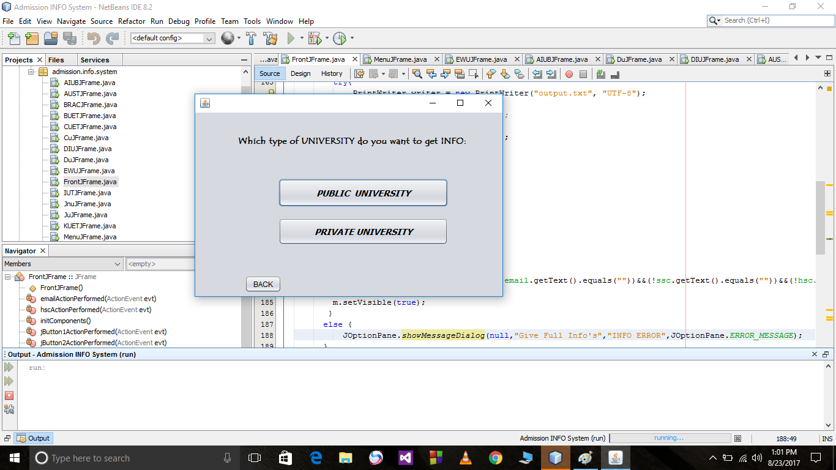
UNIVERSITY TYPE…

Slide 7
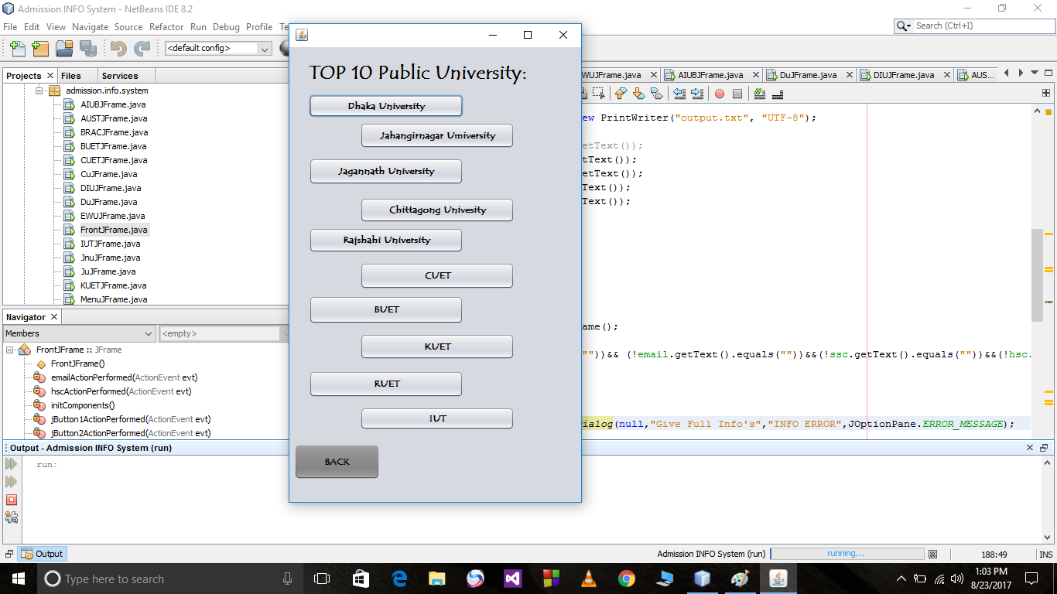
TOP 10 Public University…

Slide 8
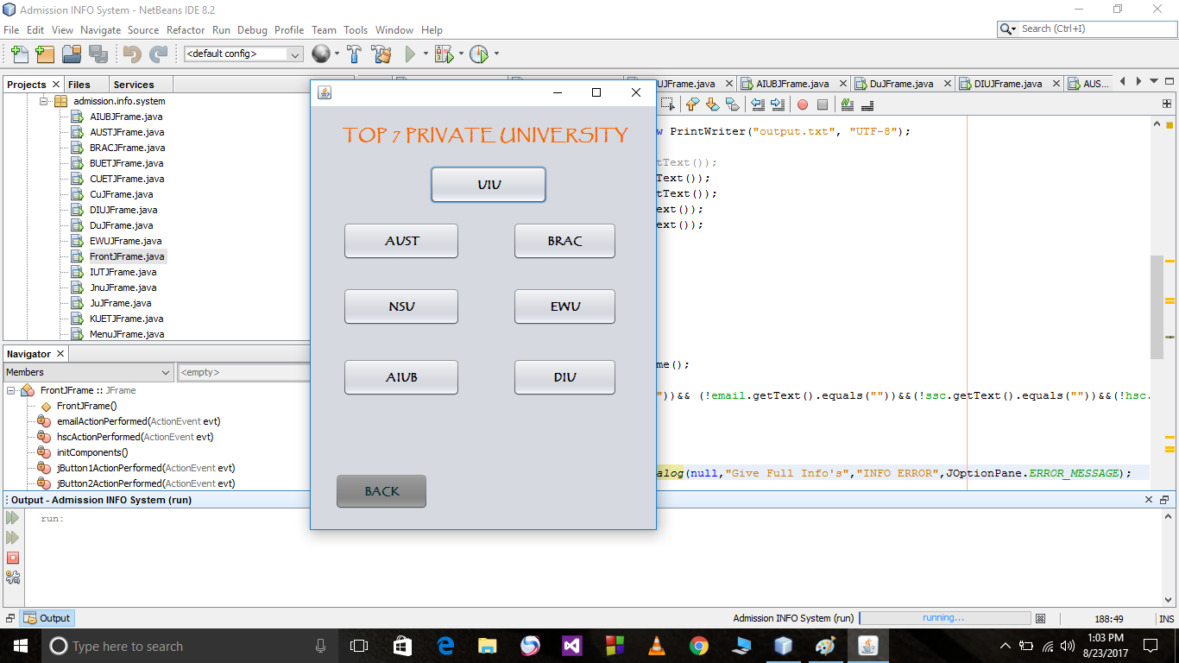
Top 7 Private University…

Slide 9
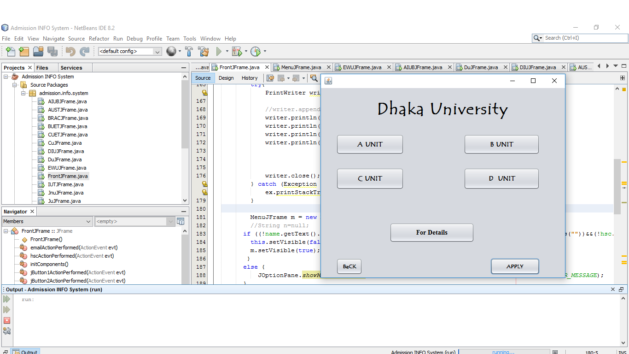
INFO of University Admission…

Slide 10
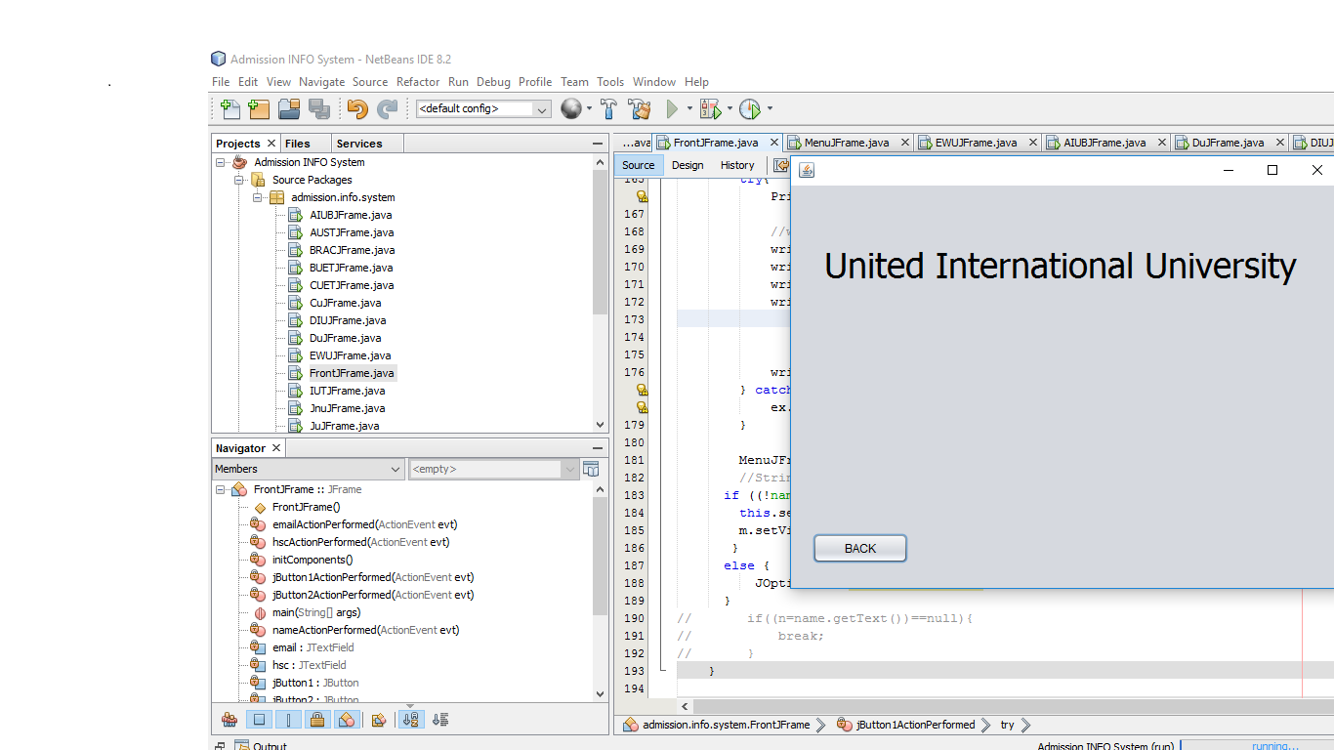
University Admission Info…

Slide 11
FUTURE UPDATES
Make this app better…
Make this app available for every candidates…
Give more specific INFORMATION…..
Provide Mobile Application….
Connect with Internet….

Slide 12
THANK YOU……..

